Slide 1


The market basket analysis of Nexus
Course: Capstone: create value from open data
Student: Nino požar
13th March 2019

Slide 2




Nexus is a UK-based and registered non-store online retail. The company mainly sells unique all-occasion gifts.
The management of company is not satisfied with current amount of sales and believe they can improve them by using analytics approach.
The company wants to improve it’s sales and earnings by introducing recommender system that will group similar items together.
By introducing the system, Nexus wants to gain much needed competitive advantage.
At average, if online retail company successfully implements market-basket-based recommender systems, sales improve about 15%, with ROI at average of 112%.
2.5 MIL. ₤ SALES INCOME
112% ROI
15% MORE SALES

Slide 3
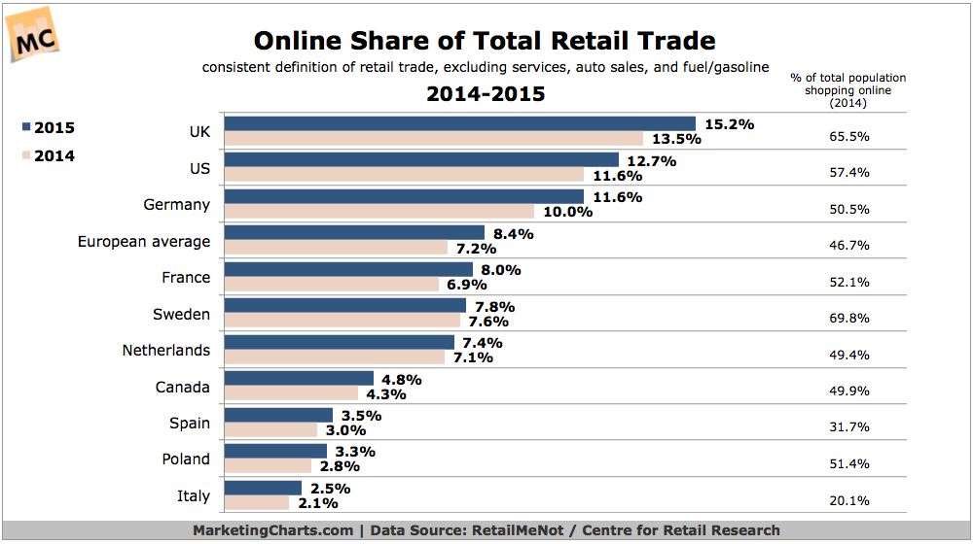
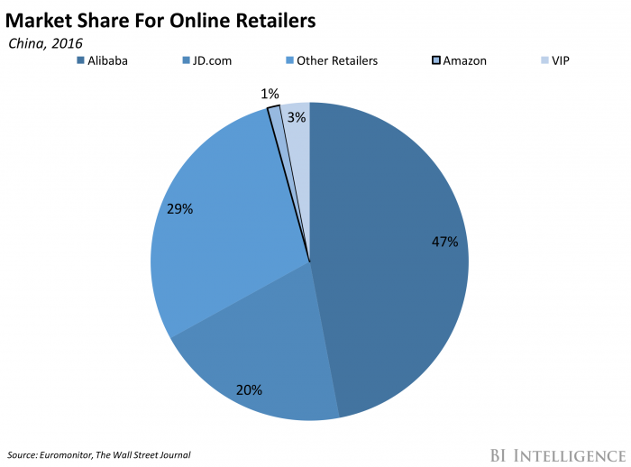
Market situation
The number of online share of total retail is growing, specially in the UK where in 2015 15.2% of retail happens online.
„Big guys” on market are still Alibaba, JD and Amazon.
Nexus must implement analytics to compete with top retailers.
Key to improve sales is to become customer centric, and by applying analytics, Nexus can achieve that.
Available at: https://www.marketingcharts.com/industries/retail-and-e-commerce-53439
Available at: https://www.businessinsider.com/amazon-is-struggling-to-find-its-place-china-2017-8

Slide 4
Data and analysis framework
GETTING DATA
Data is available at : UCI Machine Learning Repository
RAW VARIABLES:
InvoiceNo: Invoice number. Nominal, a 6-digit integral number uniquely assigned to each transaction. If this code starts with letter 'c', it indicates a cancellation. StockCode: Product (item) code. Nominal, a 5-digit integral number uniquely assigned to each distinct product. Description: Product (item) name. Nominal. Quantity: The quantities of each product (item) per transaction. Numeric. InvoiceDate: Invice Date and time. Numeric, the day and time when each transaction was generated. UnitPrice: Unit price. Numeric, Product price per unit in sterling. CustomerID: Customer number. Nominal, a 5-digit integral number uniquely assigned to each customer. Country: Country name. Nominal, the name of the country where each customer resides.
DATA PREPROCESSING:
Data was preprocessed by removing missing values, factorizing strings and decomposing date into day, month and year. More preprocessing was done based on analysis we were doing.
EXPLORATORY DATA ANALYSIS:
In EDA we analyzed how sales change over time, looking for patterns, we analyzed where sales come from and looked which are most profitable and most sold items.
MARKET BASKET ANALYSIS:
We completed MBA using apriori algorithm and observed which items are most frequently bought together and what are customer’s association rules.
REPORTING AND CONCLUSIONS:
Based on the analyses we have completed, we provided Nexus with informative and concise recommendations on how to implement their own recommender system that groups items frequently brought together.

Slide 5





Market basket analysis
- MBA is one of the key techniques used by large retailers to uncover associations between items.
- Association rules are widely used to analyze retail basket or transaction data, and are intended to identify strong rules discovered in transaction data using measures of interestingness, based on the concept of strong rules.
- For a online retail company such as Nexus, this kind of analysis is of utmost importance. Companies that understand it’s customers and their online behavior have big competitive advantage.
- Online retail companies such as Craigslist, E-Bay and Amazon are great examples of companies that utilized MBA to become leaders in the field.
- MBA can be conducted in R using apriori algorithm.
- Both stakeholders, the company and customer gain value from the implementation of MBA findings.
Company value
Sales
Profit
Customer satisfaction
Loyalty
Company
Customers

Slide 6
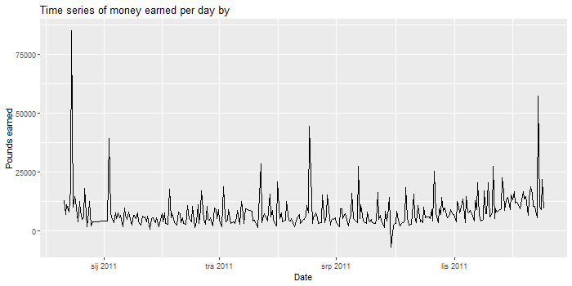
Overall sales of Nexus
Management is not satisfied with current sales.
CONCLUSIONS ABOUT DAILY SALES
Sales are pretty much static over the year
There are clear patterns of increased sales, specially around holidays in December
There is lower amount of sales on weekends, which is expected since Nexus does not accept orders on Saturdays or Sunday mornings
THE GOAL IS TO IMPROVE SALES AND GAIN PROFIT!
Table 1. Amount of sales par day of the week
Monday | Tuesday | Wednesday | Thursday | Friday | Saturday | Sunday
94933 | 101516 | 94246 | 103550 | 81835 | 0 | 64375

Slide 7
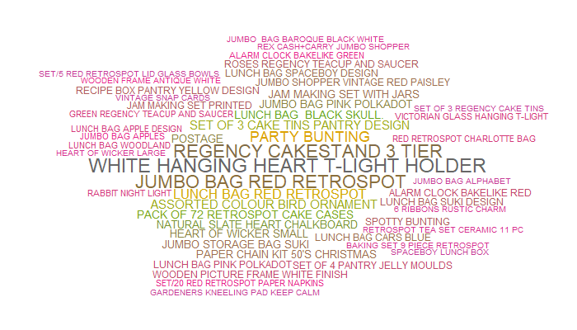
Exploratory Data Analysis
Word could of most frequently sold items

Slide 8
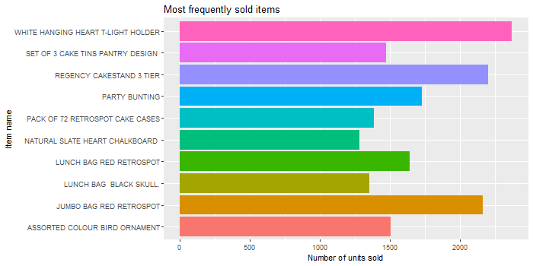
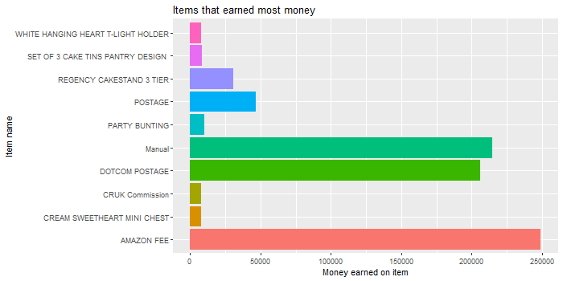
Which are most profitable items?
- Nexus mostly sells „white hanging heart t-light holder”, „regency cakestand 3 tier” and „jumbo bag red retrospot”. All those items were sold more than 2000 times in the last year.
- Nexus gains most profit from indirect costs, rather than items itself. Most money is earned on „Amazon fee”, „Manual” and „Dotcom postage”. This is valuable information that can further be used for business purposes.

Slide 9
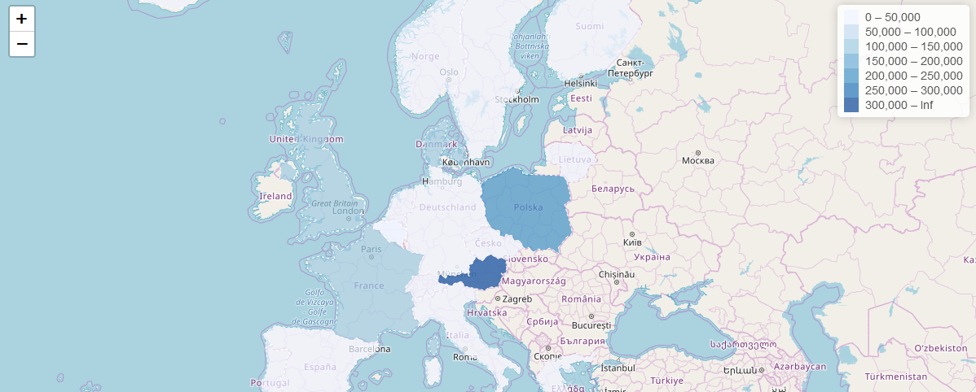
Where do our customers come from?
WESTERN Europe (Austria, Poland, France and the UK)

Slide 10
EDA Conclusions
- There are no items with extremely high rate of purchase. 2369 sold items of „white hanging heart t-light holder” is most of any item and equals 0.05% of all items sold.
- Nexus could lower the costs of shipping, something that should be beneficial to both, the company and the customer.
- Even though Nexus is worldwide online retail company, it still sells most of it’s products to European market, specifically Austria, Poland, France and the UK.
- The indicators used in this analysis were correct ones and drove significant, relevant and meaningful results. The interpretation was easy and straightforward, and provided some high-end and easy-to-understand visuals.

Slide 11
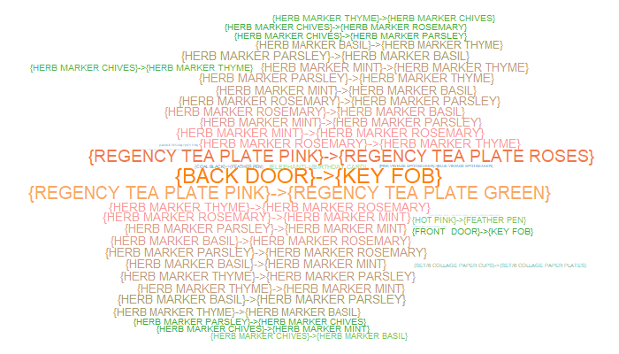
Market Basket Analysis
Word could of most frequently sold Pairs of items

Slide 12
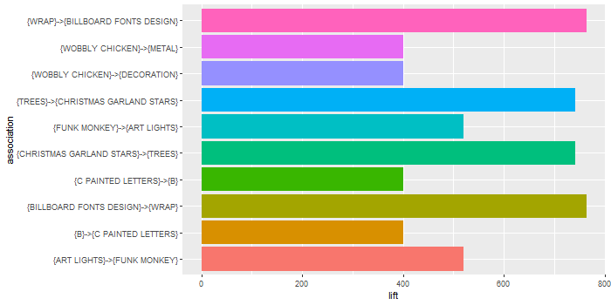
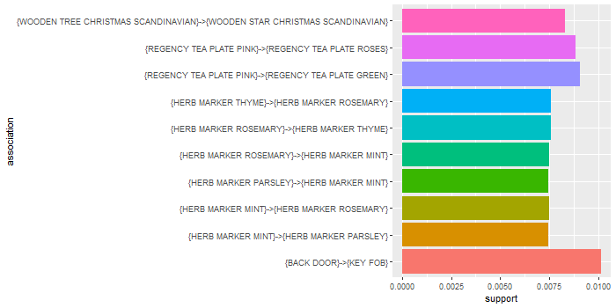
Which items are most frequently bought together?
- We can see that most frequently our customers buy back door with key fob with support of 0.01. It is closely followed by regency tea plate pink and regency tea plate green.
- The highest lift is the one of wrap and billboard fonts design; and trees and Christmas garland stars. This means that this combination of items most frequently occurs together, rather than alone in the basket.
Lift is the ratio of the support of x occurring together with y divided by the probability that x and y occur if they are independent.
Support is the proportion of the transactions in the data that contain an itemset of interest.

Slide 13
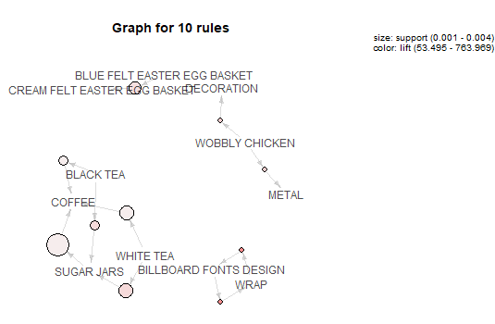
Connections between most frequently sold items

Slide 14

MBA Conclusions
- There are 4678 association rules in the data. This means that 4678 items follow specific patter in in how they are paired in customer’s basket.
- Several pairs of association rules can be used to improve out selling strategy
- All the indicators used are great to develop the aforementioned strategies. No additional data is needed for this kind of analysis and our analysis was successful.

Slide 15
Recommendations
1. Create special offers of items frequently bought together (e.g. trees and Christmas garland stars and back door with key fob) which would be attractive to customers.
2. Use yearly data that showed higher sales during holidays to adjust marketing strategies. By that we mean accessing customers with special offers, giveaways and seasonal items.
3. Improve sales in big market countries. Big markets such as Spain, Germany and Italy hold big potential and company must adjust marketing strategies to attract more customers from this area. Also we recommend to spread customer base on Eastern Europe. More data and analyses are to better understand socio-demographic segmentation of customers.

Slide 16

Value created and Conclusions
The data and analyses were successful and we provided valuable and meaningful recommendations to Nexus management.
If Nexus implements our recommendations, sales are expected to grow about 10% with ROI over 100%.
Further work will be dedicated to overall marketing plan for Nexus based on our finding, along with market testing.
100% ROI
10% MORE SALES

